Slide 1
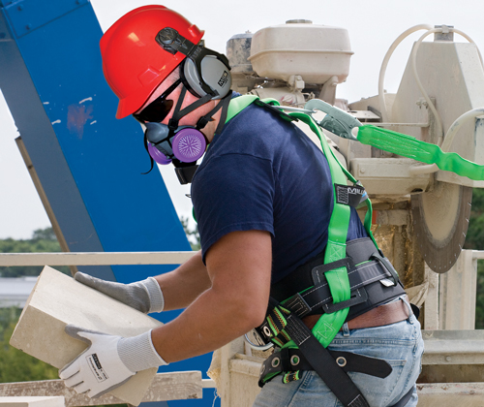
Personal Protective Equipment (PPE)

Slide 2
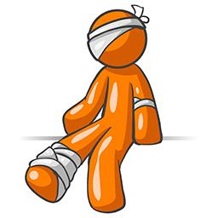
Did You Know
"The Bureau of Labor Statistics estimates that approximately 3.3 million serious work-related injuries and about 4,300 fatalities occur annually.
OSHA's incident data indicate that a significant portion of all work related injuries and fatalities involve workers being struck in the eyes, head, face, hand, and or feet by foreign objects. For example, it has been estimated that as many as 2,500 eye injuries occur in the workplace every working day
Notes:
The data provided from Bureau of Labor Statistics and fluctuates annually.

Slide 3
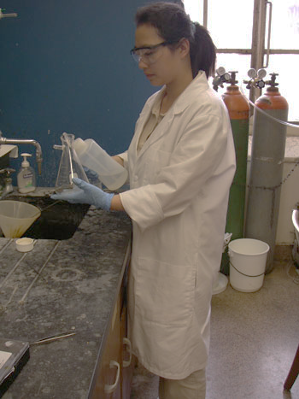
Importance of PPE?
When hazards can not be eliminated through engineering and /or administrative controls, PPE must be used to protect the eyes, face, head, feet, hands, arms, body, ears, and lungs.
Preventable Injuries
Chemical burns/irritation to the eyes/skin
Respiratory issues
Particulate matter in the eye
Heat burns
Slips, trips, and falls
Cuts and abrasions
Notes:
Engineering controls involve physically changing a machine or work environment.
Administrative controls involve changing how or when employees do their jobs, such as scheduling work and rotating employees to reduce exposures.
Work practices involve training workers how to perform tasks in ways that reduce their exposure to workplace hazards.

Slide 4
Cal-OSHA Requirements
The employer shall require employees to use the required personal protective equipment.
Personal protective equipment required by these orders shall be approved and distinctly marked so as to facilitate identification.
Personal protective equipment shall be used in accordance with the manufacturer's instructions.
The employer shall assure that employee-owned personal protective equipment complies with these regulations and that this equipment is maintained in a safe, sanitary condition
Protectors shall be of such design, fit and durability as to provide adequate protection against the hazards for which they are designed. They shall be reasonably comfortable and shall not unduly encumber the employee's movements.

Slide 5
PPE & EMPLOYEE CONTRACT LANGUAGE
Section 2: SAFETY TRAINING, EQUIPMENT, CLOTHING AND DEVICES
A. The District agrees to furnish safety equipment, clothing and devices required to maintain a safe and healthy environment for its unit members and to comply with all local, state, and federal statutes regarding such safety items. In turn, all unit members agree to comply with all safety rules, procedures and precautions and to use all furnished or required safety equipment, clothing or devices. The Association agrees to cooperate wherever possible in encouraging unit members to adhere to the spirit of this Section.
Notes:
Article X in The Collective Bargaining Agreements, Safety Conditions of Employment, spells out the district & employee responsibilities pertaining to PPE. This particular paragraph came from the OSS contract, OTBS has similar language.

Slide 6
Common excuses for not wearing PPE
Uncomfortable
Hot
Restrict movement
They make it harder to get the job done
Notes:
Sometimes these things are true, but the inconvenience is a small price to pay for safety. A work related injury may disable you for life. The right PPE used in an appropriate manner can reduce the danger of injury. In addition, codes, regulations, district policies, and contract language require the use of PPE.

Slide 7
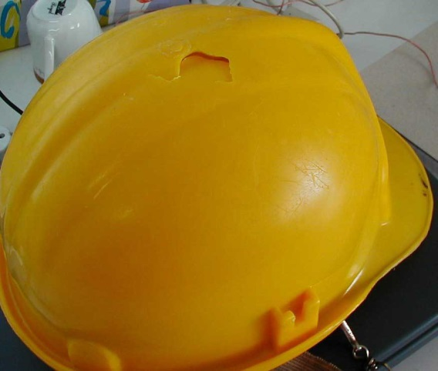
Don’t Forget about the Hardhat
Protects the head from falling or flying objects
Cushions the blow if you hit your head on an object
Non conductive hardhats insulate you from burns and shocks
Hardhats can keep your hair from becoming entangled in machinery or equipment
Damaged Hardhat

Slide 8
Hardhats
What is the suspension in a hardhat for?
How should you adjust it?
A: The suspension keeps a cushion of air between the outer shell and your head.
The cushion of air is important protection. Don't interfere with it. Never carry anything (like tools or cigarettes) inside your hardhat while you're wearing it.
Adjust the suspension so there's 1¼ inches between the top of your head and the shell. (If the manufacturer's directions are different, follow those.)
How often should you inspect a hardhat?
When should you replace it?
Inspect the entire hardhat every day. Replace it immediately if you see damage to the shell, liner, or suspension.
Don't decorate the hardhat. You may not be able to see damage if it has been painted or covered with stickers.
Replace the hardhat if there has been a significant impact, even if you can't see any damage. The impact may have weakened it.
Change the suspension in a hardhat for each new user.

Slide 9
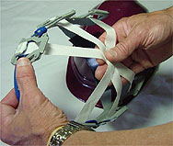
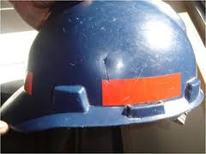
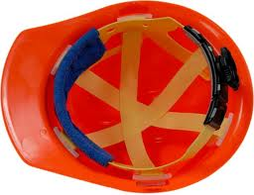
Hardhats
Inspect exterior & interior including the webbing & exterior
See the damage?
Notes:
Always inspect your hard hat shell and suspension before and after use. Look for:
•breakage or cracks in the shell and suspension
•brittle, discolored or "chalky" plastic
•loss of suspension flexibility
•frayed suspension straps or stitching
The hardhat on the bottom has been painted making it difficult to detect cracks or other defects. Never paint a hard hat. Paint may chemically attack and damage the hard hat’s shell, thereby reducing the degree of protection originally provided.
Do not alter, modify or drill holes in the hard hat shell in any manner unless specifically allowed by the written instructions that come with the hard hat or accessory. This will greatly reduce the degree of protection provided by the shell.
Note: Items such as gloves, cigarettes and earplugs should NEVER be stored between the suspension and the shell. This space is needed when the shell and suspension absorbs the energy of an impact. Such objects in this space can transmit large forces to the head and neck, resulting in serious injury or death.

Slide 10
Processes That May Require Head Protection
Can tools or other objects fall from above
Work stations or traffic routes located under catwalks or conveyor belts, construction, trenching, utility work
Is your head near exposed beams, machine parts, pipes, etc.
Confined space operations, building maintenance
Work with or near exposed electrical wiring or components
Building maintenance, utility work, construction; exposed electrical work, arc or resistance welding
Notes:
Ask yourself the following:
Bullet 1: Might tools or other objects fall from above and strike your head? This may involve work stations or traffic routes located under catwalks or conveyor belts, construction, trenching, utility work, etc.
Bullet 2: Is your head, when you stand or bend, near exposed beams, machine parts, pipes, etc.? This may be a construction area, confined space operations, building maintenance, etc
Bullet 3: Do you work with or near exposed electrical wiring or components? This may include building maintenance; utility work; construction; wiring; work on or near communications, computer, or other high tech equipment; arc or resistance welding; etc.

Slide 11
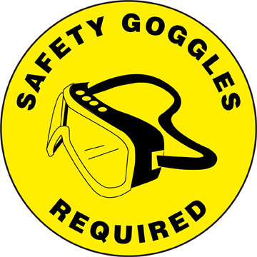
Eye Protection
You may need eye protection when there's danger from:
flying particles (from saws, drills, etc.)
splashes
dust
protruding or projecting parts
chemical vapors or fumes
bright light or ultraviolet rays (from welding, lasers, etc.)

Slide 12
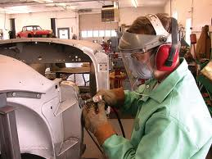
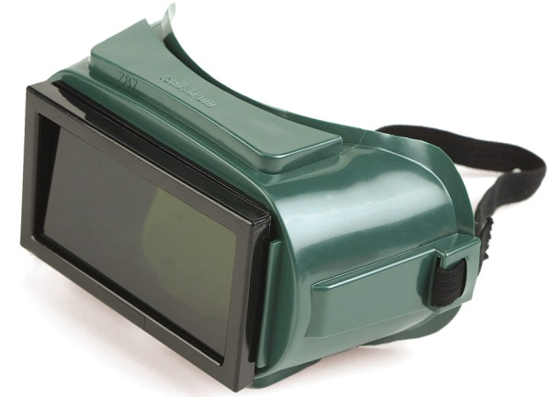
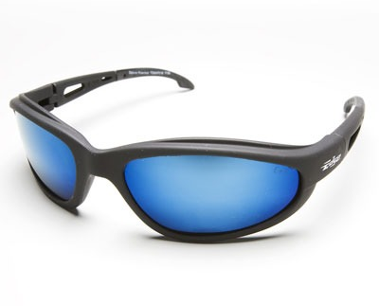
Eye Protection
What types of eye protection are there?
How do you know which kind to use?
Notes:
Depending on the particular hazard, you may need safety glasses with side shields, goggles, or a full face shield. Tinted or shaded lenses may be needed for protection against glare or specially numbered lens for protection from radiant energy (welding etc). Keep in mind that tinted or shaded lenses may limit your vision moving from bright to dim/low light areas.
We'll give you the right kind for the job you're doing. If you wear goggles, there are several types. With acids and some other chemicals, you may need special splash resistant goggles.
NOTE: Don't wear contact lenses on a construction site unless approved by a doctor.

Slide 13
Processes That May Require Eye Protection
Sawing, cutting, drilling, sanding, grinding, hammering, chopping, abrasive blasting, punch press operations
Pouring, mixing, painting, cleaning, syphoning, dip tank operations and health care services
Battery charging, installing fiberglass insulation, compressed air or gas operations
Welding, cutting, laser operations
Notes:
Consider the following when determining if you need eye protection:
Tasks that might produce airborne dust or flying particles - Sawing, cutting, drilling, sanding, grinding, hammering, chopping, abrasive blasting, punch press operations.
Working or handle, hazardous liquid chemicals or encounter blood splashes - Pouring, mixing, painting, cleaning, syphoning, dip tank operations, and health care services.
How about being exposed to operations that have intense light or lasers - Welding, cutting, brazing and laser operations.

Slide 14
Processes That May Require Face Protection
Pouring, mixing, painting, cleaning, syphoning, dip tank operations
Welding, pouring molten metal, smithing, baking, cooking, drying
Cutting, sanding, grinding, hammering, chopping, pouring, mixing, painting, cleaning, syphoning
Notes:
Bullet 1
Do you handle, or work near employees who handle, hazardous liquid chemicals?
Bullet 2
Is your face exposed to extreme heat?
Bullet 3
Is your face exposed to other potential irritants?

Slide 15
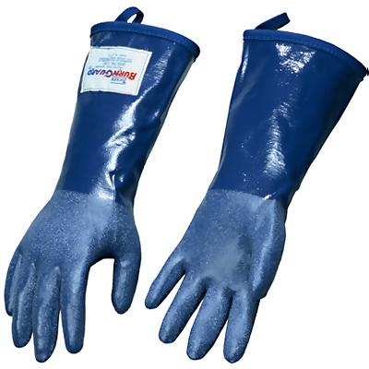
Hand Protection
Gloves can help protect you from:
flying particles
electricity
cuts
chemicals and radioactive material
cold or wet surfaces or environments
burns
How do you choose the right glove for the job?
Notes:
Use wire mesh gloves if there's an extreme danger of cuts.
Use insulated rubber gloves (with canvas or leather outer gloves) for electrical work.
Use non-flammable gloves when welding.
Only special chemical resistant gloves (rubber or plastic) will protect you from chemicals. Different types stop different chemicals from getting through to your skin. The package should tell you which chemicals the glove is designed for. Chemical resistant gloves break down over time. Then the chemicals start to get through. Don't use them beyond their intended service time (shown on the package).

Slide 16
Processes That May Require Hand Protection
Grinding, sanding, sawing, hammering, material handling
Pouring, mixing, painting, cleaning, syphoning, dip tank operations, health care and dental services
Welding, pouring molten metal, smithing, baking, cooking, drying
Building maintenance, utility work, construction, electrical work, arc or resistance welding
Notes:
Ask yourself the following:
Does your hands come into contact with tools or materials that might scrape, bruise, or cut? This may include grinding, sanding, sawing, hammering, material handling, etc.
Do you handle chemicals that might irritate skin, or come into contact with blood? This may involve pouring, mixing, painting, cleaning, syphoning, dip tank operations or nurses.
Do work procedures require you to place your hands and arms near extreme heat? This may apply to Welding, pouring molten metal, iron work, baking, cooking, drying or other operations involving heat.
Are your hands and arms placed near exposed electrical wiring or components? Building maintenance; utility work; construction may involve operations that would require gloves specific for the work you are performing.

Slide 17
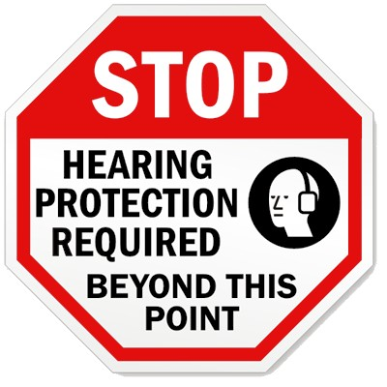
Hearing protection & training
Workers must wear hearing protection when:
They are exposed to a sound level of 85 dBA or greater and have had a standard threshold shift in hearing.
They are exposed to noise in excess of the limits set in Cal/OSHA Title 8, Section 5096.
Workers exposed to noise at or above 85 dBA for 8-hour TWA shall participate in an annual training program.
Employees can opt to wear hearing protection, even when not specifically required by code or policy.

Slide 18
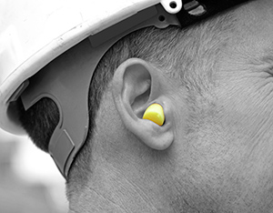
Hearing Protectors
When engineering and/or administrative controls either fail to reduce noise to within required limits or are not technologically feasible, hearing protectors must be used.
When either earmuffs or ear plugs are used, sufficient variety should be available to insure that workers can get a good fit.
Protective devices should be both effective and comfortable. Sized ear plugs are made of soft, flexible materials which will conform to the shape of the wearer’s ear canal. Other plugs are malleable, made of cotton, paper, plastic, and other materials. They can be thrown away after each use and are designed to fill all ears.
When ear muffs are used, make sure that the seal between the muff and the head is tight. Long hair, glasses, and other obstructions may diminish the effectiveness of the device.

Slide 19
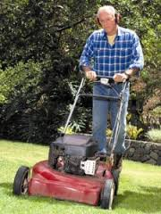
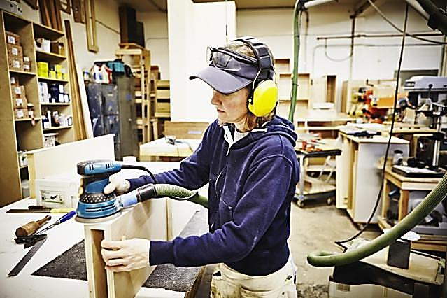
Processes That May Require Hearing Protection
Machining, grinding, sanding, work near conveyors, pneumatic equipment, generators, ventilation fans, motors, punch and brake presses
Notes:
Are you exposed to loud noise from machines, tools, music systems, etc.?

Slide 20
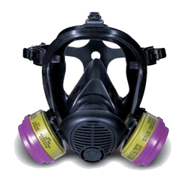
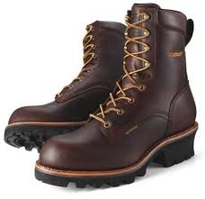
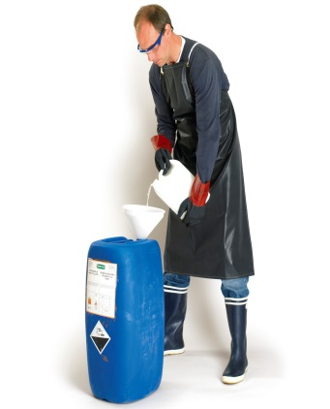
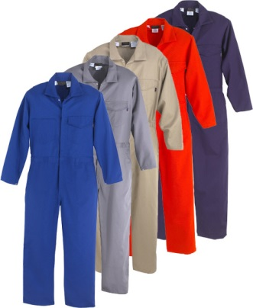
Other ppe you may need
Wear steel-toed safety shoes when anything might crush or penetrate your foot.
If you're using a jackhammer, steel should cover your whole foot, not just the toes.
Wear boots when you work near hot surfaces, with concrete, or in wet locations, (ensure boots used in wet locations provide adequate traction).
Knee pads protect the knees from hard/sharp
Wear an apron or coveralls to protect yourself from dust, chemicals, cuts, and burns.
A full body suit may be necessary if you work with asbestos, lead, or toxic waste. It can also protect you from steam and from extreme heat or cold.
Respiratory protection may be required for certain trades and/or processes. The use of tight fitting respirators requires a physical exam, doctors approval for the employee to wear them, training, & a respiratory fit test.

Slide 21
Determining if you need other types of PPE
Is your body exposed to irritating dust or chemical splashes?
How about being exposed to acids or other hazardous substances?
Maybe being exposed to extreme heat?
A PPE guideline is available on the OSHA website at http://www.osha.gov/dte/library/ppe_assessment/ppe_assessment.html
Notes:
Other types of PPE may be required depending on the work. This may include but not limited too welding jacket, respirator, chemical apron, coveralls/tyvek suit, fall protection (harness), etc.
Operations may include but are not limited to:
1. Pouring, mixing, painting, cleaning, syphoning, dip tank operations, machining, sawing, battery charging, installing fiberglass insulation, compressed air or gas operations.
2. Cutting, grinding, sanding, sawing, glazing, material handling
3. Welding, pouring molten metal, smithing, baking, cooking, drying

Slide 22
Cleaning and Maintenance
It is important that all PPE be kept clean and properly maintained by the employee assigned to the equipment.
Cleaning is particularly important for eye and face protection. Dirty or fogged lenses can impair vision.
Cleaning of respiratory protection after use and changing out filters on a regular basis is very important. Filters become clogged after a period of time making it difficult to breath.
PPE must be inspected, cleaned, and maintained by employees at regular interval and as stated in the manufacture’s instructions.

Slide 23
Cleaning and Maintenance
If the PPE is in need of repair or replacement, it is the responsibility of the employee to bring it to the immediate attention of his/her supervisor.
Do not use PPE if it is in need of repair or if it is not able to perform its intended function.
Contaminated PPE, which cannot be decontaminated, must be disposed of in a manner that protects employees from exposure to the hazard and should be brought to the attention of your supervisor.

Slide 24
Hazards in the Workplace
It may include:
Impact hazards
Penetration hazards
Compression hazards
Chemical hazards
Heat
Harmful dust
Optical radiation
Biological hazards
Noise hazards
Electrical hazards
Other
Notes:
Impact hazards
Falling objects or potential for dropping objects.
Penetration Hazards
Objects or machinery that may cause punctures, cuts, or abrasions.
Compression Hazards
Machinery/heavy objects that may roll over and crush or pinch feet.
Chemical Hazards
Chemical exposures from inhalation or contact with the skin and eyes.
Areas and departments must maintain a current list of hazardous chemicals used in their local operations.
Area and department supervisors are responsible for conducting, maintaining, and updating the inventory for the employees work location.
NOTE: Safety Data Sheets
It is the responsibility of the supervisor to ensure that SDSs for all hazardous substances identified on the hazardous materials inventory are available and accessible to all employees when they would be working with chemicals.
SDSs contain important information on appropriate PPE.
Heat Hazards
Hot work areas and sources of high temperature that could result in burns, eye injury, or ignition of PPE.
Harmful Dust
Dust from sandblasting, sawing, grinding, or other generation of airborne dust.
Optical Radiation
Sources of light radiation (welding, cutting, lasers, high intensity lights).
Biological Hazards
Exposures to blood or other body fluids, mold, or other biological exposures.
Noise Hazards
Excessive noise (louder than a hair dryer).
Electrical Hazards
Electrical panels, any equipment that has to be energized to perform service/maintenance work

Slide 25
Other Considerations
If you are unsure what PPE is required for a specific job task ask your Supervisor, Leadman, or crew leader.
When working with products or chemicals consult the Safety Data Sheet (SDS). The SDS will tell you the ingredients, hazards, conditions to avoid, and what PPE you need.
In California the employer must supply ANSI approved PPE required by Cal/OSHA.
Protective gear supplied by the employee must also comply with Cal/OSHA and ANSI requirements.
Notes:
For personnel who work at Physical Plant Operations (PPO) some PPE is available through the warehouse. Check with your supervisor for availability.

Slide 26
Where to get more information
Safety Office web site http://www.sandi.net//Domain/144
Safety office phone 858-627-7174
Department of Industrial Relations web site www.dir.ca.gov

